Slide 1
Historic Year 2019-2023 and Forecast to 2032
Global Market of Computers
Type_1: Point_1.1, Point_1.2 (Sub_point_1.2.1) Type_2: Point_2.1 By Region: North America, Europe, Asia-Pacific, Latin America, Middle East & Africa

Slide 2
MARKET SEGMENTATION
Global Market of Computers(USD MILLION)
YEARS CONSIDERED :
Historical year - 2019-2023 | Base year - 2024 | Forecast year - 2025-2032
BY TYPE_1
BY TYPE_2
Point_1.1
Point_1.2
Point_2.1

Slide 3








MARKET TAXONOMY
Global Market of Computers(USD MILLION)
YEARS CONSIDERED :
Historical year - 2019-2023 | Base year - 2024 | Forecast year - 2025-2032
NORTH AMERICA
EUROPE
ASIA PACIFIC
LATIN AMERICA
MIDDLE EAST & AFRICA
Mexico
GCC Countries
United Kingdom
China
Brazil
Canada
Germany
France
Japan
Spain
South Korea
United States
Italy
India
South Africa
United Kingdom
Germany
France
Spain
GCC Countries
South Africa
Rest of MEA
Italy
Rest of Europe
China
Japan
India
Brazil
Mexico
Rest of LATAM
United States
Canada
South Korea
Rest of APAC

Slide 4
TABLE OF CONTENTS-
Global Market of Computers-
Historic Year 2019-2023 and Forecast to 2032

Slide 5

TABLE OF CONTENTS
1. Introduction | 4.6.1. Competitive Rivalry
1.1. Objectives of the Study | 4.6.2. Threat of substitutes
1.2. Market Definition & Scope | 4.6.3. Bargaining power of buyers
2. Research Methodology | 4.6.4. Threat of new entrants
2.1. Research Process | 4.6.5. Bargaining power of suppliers
2.2. Secondary & Primary Data Methods | 6. Global Market of Computers Size by Type_1 (2025-2032)
2.3. Market Size Estimation Methods | 6.1. Point_1.1
2.4. Market Assumptions & Limitations | 6.2. Point_1.2
3. Executive Summary | 6.2.1. Sub_point_1.2.1
3.1. Global Market Outlook | 7. Global Market of Computers Size by Type_2 (2025-2032)
3.2. Key Market Highlights | 7.1. Point_2.1
3.3. Segmental Overview | 8. Global Market of Computers Size by Region (2025-2032)
3.4. Competition Overview | 8.1. North America (By Type_1, By Type_2)
4. Market Dynamics & Outlook | 8.1.1. US
4.1. Macro-Economic Indicators​ | 8.1.2. Canada
4.2. Drivers & Opportunitiess | 8.2. Europe (By Type_1, By Type_2)
4.3. Restraints & Challenges | 8.2.1. UK
4.4. Supply Side Trends | 8.2.2. Germany
4.5. Demand Side Trends | 8.2.3. Spain
4.6. Porter's Analysis & Impact | 8.2.4. France

Slide 6
TABLE OF CONTENTS
8.2.5. Italy | 9.4. Recent Developments in the Market
8.2.6. Rest of Europe | 9.5. Company Market Share Analysis, 2024
8.3. Asia-Pacific (By Type_1, By Type_2) | 10. Key Company Profiles
8.3.1. China | 10.1. Apple Inc.
8.3.2. India | 10.1.1. Company Overview
8.3.3. Japan | 10.1.2. Product Portfolio Overview
8.3.4. South Korea | 10.1.3. Financial Overview
8.3.5. Rest of Asia Pacific | 10.1.4. Key Developments
8.4. Latin America (By Type_1, By Type_2) | The following companies are listed for indicative purposes only. Similar information will be provided for each, with detailed financial data available exclusively for publicly listed companies.
8.4.1. Brazil | 10.2. Microsoft Corporation
8.4.2. Mexico | 10.3. Dell Technologies Inc.
8.4.3. Rest of Latin America | 10.4. Lenovo Group Limited
8.5. Middle East & Africa (By Type_1, By Type_2) | 10.5. Hewlett-Packard Company
8.5.1. GCC Countries | 10.6. AsusTek Computer Inc.
8.5.2. South Africa | 10.7. Acer Inc.
8.5.3. Rest of Middle East & Africa | 10.8. IBM Corporation
9. Competitive Dashboard | 10.9. Samsung Electronics Co. Ltd.
9.1. Top 5 Player Comparison | 10.10. Toshiba Corporation
9.2. Market Positioning of Key Players, 2024 | 11. Conclusion & Recommendation
9.3. Strategies Adopted by Key Market Players

Slide 7
TABLE OF CONTENTS

Slide 8
TABLE OF CONTENTS

Slide 9
RESEARCH METHODOLOGY
Global Market of Computers -
Historic Year 2019-2023 and Forecast to 2032

Slide 10
RESEARCH METHODOLOGY
Research Objective
The process begins with clearly defining the research objective, which serves as the foundation for the study. This step identifies the specific goals, questions, or problems the research aims to address.
Research Objective
Secondary Research
Secondary research involves collecting existing data from credible sources to build a comprehensive baseline. This stage gathers relevant insights to contextualize the study and identify data gaps.
Data Modelling
Secondary Research
Data Analysis
Primary Research
Primary Research
Primary research directly gathers first-hand data to validate, complement, or update insights obtained during secondary research. It involves interacting with industry stakeholders to provide real-time insights and market perspectives.
Data Modelling
This step involves using data modeling techniques to forecast future trends and market behavior. Predictive modeling ensures informed decision-making by aligning results with economic, industry, and population metrics.
Data Analysis
Data collected through secondary and primary research is rigorously analyzed to uncover patterns, trends, and actionable insights. This step ensures that findings are relevant, consistent, and aligned with the research objectives
Data Reporting
The findings and insights are compiled into a detailed, well-structured report that aligns with the client's needs and objectives. The report provides actionable recommendations and data-driven conclusions.
Data Reporting

Slide 11

SECONDARY RESEARCH
The purpose of secondary research is to build a solid foundation for understanding the target market by leveraging existing data, reports, and publications. This step is essential to gaining an initial perspective on the market size, trends, competitive dynamics, challenges, and opportunities. Secondary research helps map out broad market insights that can guide further exploration and refinement of the research focus.
Analyst's Role:
Source information from industry reports, government data, trade publications, and online repositories.
Map out the competitive landscape, market challenges, and emerging opportunities.
Highlight data gaps and refine the focus for primary research.
Data Sources
Association and Organization | Research Paper and Journal | Competition Data | Paid Databases | SkyQuest Internal Database
open | 1 | Annual Report | Factiva
open1 | 2 | Investor Presentation | Bloomberg
OPWN 2 | 3 | SEC Filling/ 10K Sizes | Hoovers
OPEN2 | 5 | Company Website | Morningstar
OPN3 | 4 | Trade Data | Seeking Alpha

Slide 12
PRIMARY RESEARCH
The purpose of executing primary research is to gather firsthand insights that validate and complement the data gathered during secondary research. By directly engaging with market participants, primary research ensures that the findings are grounded in real-world market dynamics. This step provides fresh, up-to-date, and specific information that is essential to gain a more nuanced understanding of the market, uncovering insights that secondary sources may not capture.
Analyst's Role:
Develop interview guides and surveys tailored to the study's objectives
Engage with key industry stakeholders, such as business leaders, end-users, and experts.
Capture a blend of qualitative and quantitative data, ensuring diversity in perspectives.
Break up of Primary Interviews with Industry Experts
BY COMPANY
BY DESIGNATION
BY REGION

Slide 13
EXECUTIVE SUMMARY
Global Market of Computers -
Historic Year 2019-2023 and Forecast to 2032

Slide 14

EXECUTIVE SUMMARY
MARKET OUTLOOK
FIGURE 01. Global Market of Computers, USD Million
The global market for computers is expected to showcase significant growth from 2019 to 2032 due to rapid advancements in technology and increasing demand for high-speed processors. In terms of Compound Annual Growth Rate (CAGR), the market is anticipated to grow at an impressive % over the forecast period. The global computer market, valued at substantial million USD in 2019, is projected to reach remarkable million USD by 2032. This growth can be attributed to various factors including a surge in demand from businesses, growing consumer electronic expenditures, continuous product innovation, and the increasing penetration of internet usage. The market share is anticipated to expand considerably during the forecast period, solidifying its position in the global market.
Key Market Enablers
2
Technological Advancements: The global market for computers is majorly driven by constant technological advancements. The rapid growth and advancements in technologies such as Artificial Intelligence (AI), Machine Learning (ML), Internet of Things (IoT), and big data have created a surge in demand for computers worldwide. These technologies require advanced computing power and features, thus driving the growth of the computer market. Additionally, the rise in gaming computers with advanced graphics, the emergence of computers with improved processing capabilities, and evolving computer designs significantly contribute to market expansion. Increasing Digitalization: The increasing digitalization in today's global economy is another key market enabler for the computer industry. Digital transformation across various sectors such as finance, healthcare, education and businesses have led to an increased demand for computers. With digitalization, business operations have moved from manual processes to automated systems, driving the need for computers. Also, in a bid to tide over the disruptions caused by the COVID-19 pandemic, many organizations and educational institutions have shifted to a remote-working and remote-learning model, respectively, further boosting the market for computers.
1

Slide 15
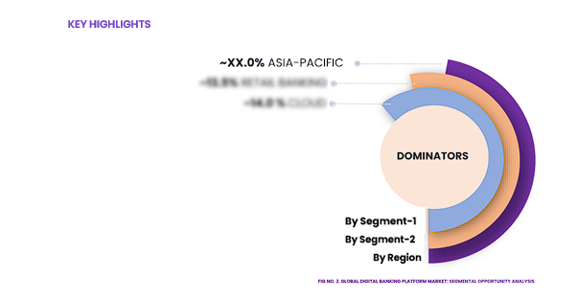
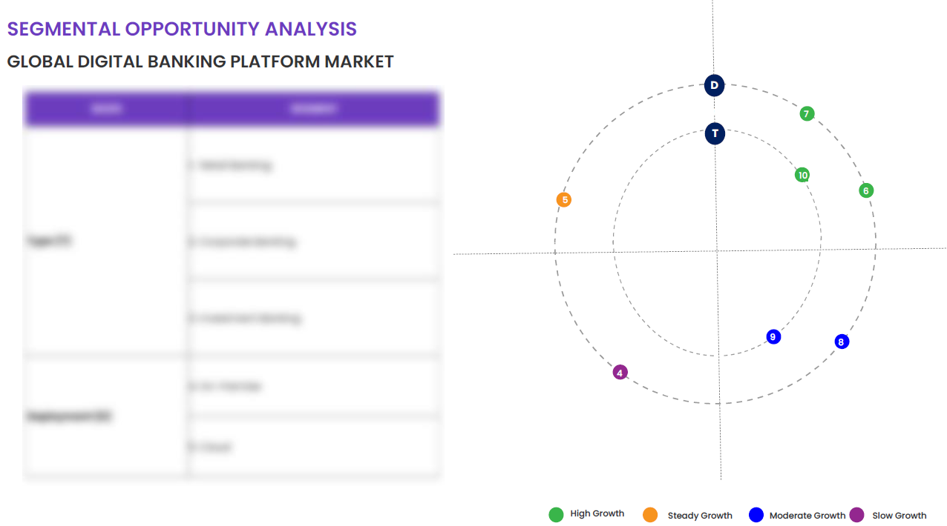
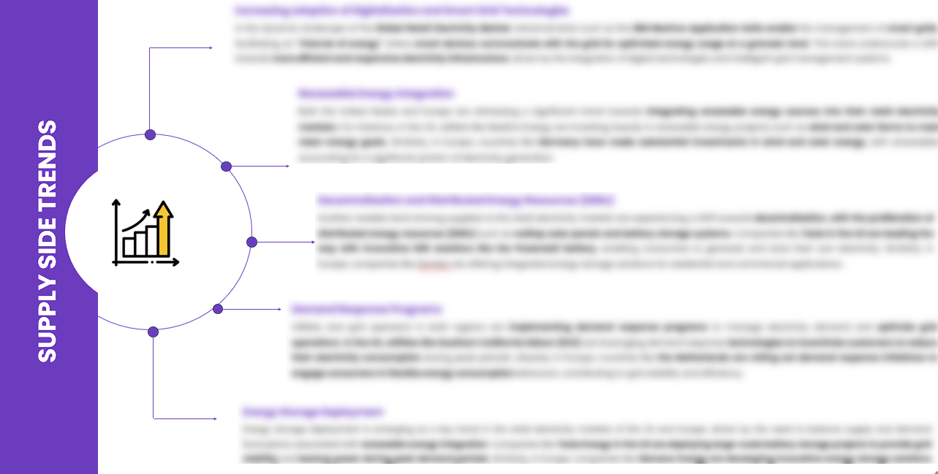
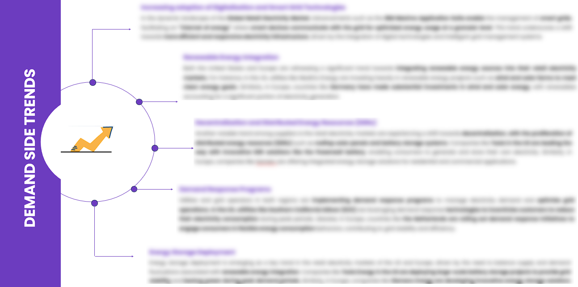
EXECUTIVE SUMMARY
SEGMENTAL OPPORTUNITY ANALYSIS
Global Market of Computers
Global Market of Computers,2024
1 Million
Global Market of Computers,2032
2 Million
SUPPLY SIDE TRENDS
DEMAND SIDE TRENDS

Slide 16
MARKET OVERVIEW
Market Drivers & Challenges
Market Attractiveness - Porters Five Analysis
Threat of New Entrants
Bargaining Power of Suppliers
Bargaining Power of Buyers
Threat of Substitute
Intensity of Competitive Rivalry
Global Market of Computers -
Historic Year 2019-2023 and Forecast to 2032

Slide 17

MARKET OVERVIEW: MARKET DRIVERS & OPPORTUNITIES
The Expanding Global Industry As A Key Driver For Global Market of Computers
The booming Type_1 industry has emerged as a vital growth driver for the global computer market. This growth is attributed to the increasing use of machine learning algorithms and data processing applications that necessitate high-speed and robust computing capabilities. Factors such as the rise of digital platforms, developments in artificial intelligence, and increasing access to high-speed internet are accelerating the scope of Type_1 industry, thereby fuelling demand for advanced computer systems. The rapid advancements in the Type_1 industry are fostering innovation and expansion in the global computer market. Extensive data generation and the need for efficient data storage, management and analysis are prompting businesses to invest in highly efficient computer technologies. This growing need for high-performance computing, predominantly in industries like healthcare, logistics, and e-commerce, is expected to keep driving market growth. Simultaneously, it is prompting computer manufacturers to shift towards the design and production of more sophisticated machines.

Slide 18

MARKET OVERVIEW: MARKET RESTRAINTS & CHALLENGES
High Initial Investment And Setup Costs Are Posing Challenge To The Growth Of The Market
The global market for computers has been experiencing a steady growth largely driven by increasing demand for faster, more efficient technology. However, high initial investment and setup costs pose a significant challenge to this growth. Particularly, manufacturers are faced with substantial costs of procuring top-grade hardware components, cutting-edge software, and sophisticated production technologies. Additionally, market entry costs are notably high, discouraging participation of smaller, innovating businesses that could potentially contribute immensely to market growth. Furthermore, the technological landscape is rapidly evolving, making it mandatory for businesses in the computer industry to constantly innovate and upgrade their offerings to stay relevant. This requires substantial R&D expenditure, which again, contributes to the high initial setup costs. Moreover, the costs related to compliance with various standardized norms, technical specifications, safety regulations, and environmental guidelines can also deter the market growth. Ultimately, the high costs limit market participation, stifling competition and hindering the broad-based expansion of the global computer market.

Slide 19




MARKET OVERVIEW

Slide 20
KEY MARKET INSIGHTS
Top Investment and White Space Opportunities
Market Ecosystem Mapping
Technological Advancements, Benefits, & Impacts
Market Attractiveness Index, 2024
PESTEL Analysis
Macro-Economic Indicators
Pricing Analysis
Regulatory Landscape
Key Success Factors
Market Impacting Factors
Patent Analysis
Raw Material Analysis
Global Market of Computers-
Historic Year 2019-2023 and Forecast to 2032

Slide 21




KEY MARKET INSIGHTS

Slide 22
GLOBAL MARKET ANALYSIS, SEGMENTAL ANALYSIS
By Type_1, By Type_2
Global Market of Computers-
Historic Year 2019-2023 and Forecast to 2032

Slide 23

GLOBAL MARKET ANALYSIS – BY Type_1
Global Market of Computers SIZE, BY Type_1, 2019-2023 (USD Million)
Key Takeaways
 | 2019 | 2020 | 2021 | 2022 | 2023 | 2024 | 2025 | 2026 | 2027 | 2028 | 2029 | 2030 | 2031 | 2032 | CAGR (2025–2032)
Point_1.1 | XX | XX | XX | XX | XX | XX | XX | XX | XX | XX | XX | XX | XX | XX | XX%
Point_1.2 | XX | XX | XX | XX | XX | XX | XX | XX | XX | XX | XX | XX | XX | XX | XX%
Total | XX | XX | XX | XX | XX | XX | XX | XX | XX | XX | XX | XX | XX | XX | XX%
*Please note that this slide represents an indicative segmentation overview. the complete level-2 segmentation analysis will be covered in the Final Report.

Slide 24
GLOBAL MARKET ANALYSIS BY REGION
Global Market of Computers -
Historic Year 2019-2023 and Forecast to 2032

Slide 25


GLOBAL MARKET ANALYSIS BY REGION
Global Market of Computers: REGIONAL ANALYSIS, 2019-2023 (USD Million)
Key Takeaways
Europe
North America secured the foremost market share at 30.4%, and this dominance is projected to persist through the forecast period. This stronghold is attributed to the region's dense concentration of market competitors and an upsurge in cancer incidence rates. Notably, the U.S. witnessed approximately 1,806,590 new cancer diagnoses in 2020, as reported by the National Cancer Institute. The continuous integration of novel technologies, incorporating artificial intelligence, and the frequent launch of low-radiation CT scans are anticipated to further contribute to the region's market growth.
Conversely, Asia Pacific is poised for noteworthy growth, projected to experience a substantial Compound Annual Growth Rate (CAGR) over the forecast period. This surge can be attributed to the ongoing development of healthcare infrastructure, particularly in burgeoning economies such as India and China. The region's high adoption rate of advanced medical imaging devices, coupled with the increasing prevalence of chronic disorders, further fuels market expansion. Notably, local manufacturers in the region are gaining prominence, bolstering market growth.
North America
APAC
MEA
Latin America
Region | 2019 | 2020 | 2021 | 2022 | 2023 | 2024 | 2025 | 2026 | 2027 | 2028 | 2029 | 2030 | 2031 | 2032 | CAGR (2025-2032)
North America | XX | XX | XX | XX | XX | XX | XX | XX | XX | XX | XX | XX | XX | XX | XX%
Europe | XX | XX | XX | XX | XX | XX | XX | XX | XX | XX | XX | XX | XX | XX | XX%
Asia-Pacific | XX | XX | XX | XX | XX | XX | XX | XX | XX | XX | XX | XX | XX | XX | XX%
Latin America | XX | XX | XX | XX | XX | XX | XX | XX | XX | XX | XX | XX | XX | XX | XX%
Middle East & Africa | XX | XX | XX | XX | XX | XX | XX | XX | XX | XX | XX | XX | XX | XX | XX%
Total | XX | XX | XX | XX | XX | XX | XX | XX | XX | XX | XX | XX | XX | XX | XX%

Slide 26
NORTH AMERICA MARKET ANALYSIS – BY Type_1
NORTH AMERICA Global Market of Computers SIZE, BY Type_1, 2019-2023 (USD Million)
 | 2019 | 2020 | 2021 | 2022 | 2023 | 2024 | 2025 | 2026 | 2027 | 2028 | 2029 | 2030 | 2031 | 2032 | CAGR (2025–2032)
Point_1.1 | XX | XX | XX | XX | XX | XX | XX | XX | XX | XX | XX | XX | XX | XX | XX%
Point_1.2 | XX | XX | XX | XX | XX | XX | XX | XX | XX | XX | XX | XX | XX | XX | XX%
Total | XX | XX | XX | XX | XX | XX | XX | XX | XX | XX | XX | XX | XX | XX | XX%
Key Takeaways
*Please note that this slide represents an indicative segmentation overview. the complete level-2 segmentation analysis will be covered in the Final Report.

Slide 27
U.S. MARKET ANALYSIS – BY Type_1
U.S. Global Market of Computers SIZE, BY Type_1, 2019-2023 (USD Million)
 | 2019 | 2020 | 2021 | 2022 | 2023 | 2024 | 2025 | 2026 | 2027 | 2028 | 2029 | 2030 | 2031 | 2032 | CAGR (2025–2032)
Point_1.1 | XX | XX | XX | XX | XX | XX | XX | XX | XX | XX | XX | XX | XX | XX | XX%
Point_1.2 | XX | XX | XX | XX | XX | XX | XX | XX | XX | XX | XX | XX | XX | XX | XX%
Total | XX | XX | XX | XX | XX | XX | XX | XX | XX | XX | XX | XX | XX | XX | XX%
Key Takeaways
*Please note that this slide represents an indicative segmentation overview. the complete level-2 segmentation analysis will be covered in the Final Report.

Slide 28
COMPETITIVE DASHBOARD Top 5 Players Comparison Market Positioning of Key Players, 2023 Strategies Adopted By Key Market Players Recent Development Market Share Analysis, 2023
Global Market of Computers -
Historic Year 2019-2023 and Forecast to 2032

Slide 29




COMPETITIVE DASHBOARD
Why SkyQuest ?
Global 3D Printing Construction Market Competition Dashboard
The following figure represents the market positioning of Global Market of Computers players for the year 2023. The market positioning of the leading player is done considering the following points:

Slide 30
COMPETITIVE DASHBOARD
COMPETITORS | Apple Inc. | Company 2 | Company 3 | Company 4 | Company5
Headquarters | 1 Apple Park Way, Cupertino, California, U.S. | - | - | - | -
No of Employees | 147,000 (2020) | - | - | - | -
Revenue (US$) 2023 | 383.29 | - | - | - | -
Segmental Revenue (US$) 2024 | - | - | - | - | -
Product Overview | - | - | - | - | -
Geographic Presence | Worldwide | - | - | - | -
Year of Establishment | April 1, 1976 | - | - | - | -
Market Position | - | - | - | - | -

Slide 31
COMPANY PROFILES
Global Market of Computers -
Historic Year 2019-2023 and Forecast to 2032

Slide 32

Apple Inc. - COMPANY OVERVIEW
COMPANY AT A GLANCE
Established | April 1, 1976
Headquarter | 1 Apple Park Way, Cupertino, California, U.S.
Ownership | Public
Revenue (US$)- 2024 | 381.62
Employees | 147,000 (2020)
Website | www.apple.com
OVERVIEW
Apple Inc. is an American multinational technology company headquartered in Cupertino, California, that designs, manufactures, and sells consumer electronics, computer software, and online services. It was founded in 1976 by Steve Jobs, Ronald Wayne, and Steve Wozniak. The company's hardware products include the iPhone, the iPad, the Mac personal computer, the iPod portable media player, the Apple Watch smartwatch, the Apple TV digital media player, and the HomePod smart speaker. Apple's software includes macOS, iOS, iPadOS, and watchOS operating systems, the iTunes media player, the Safari web browser, the iLife and iWork creativity and productivity suites, as well as professional applications like Final Cut Pro, Logic Pro, and Xcode. Apple is known for its size and revenues. Its worldwide annual revenue totalled $274.5 billion for the 2020 fiscal year.
PRODUCT OFFERING
PRODUCT NAME | DESCRIPTION
iPhone

Slide 33

Apple Inc. - FINANCIAL OVERVIEW
Apple Inc. - RECENT FINANCIALS IN USD BILLION (2022-2024) | Apple Inc. - BUSINESS REVENUE MIX, 2024 IN PERCENTAGE (%)
SKYQUEST'S TAKE ON THE COMPANY

Slide 34

Apple Inc. – KEY DEVELOPMENTS
DATE | TYPE OF DEVELOPMENT | DESCRIPTION
October 2023 | Partnership | Microsoft and Siemens are deepening their partnership by bringing the benefits of generative AI to industries worldwide. As a first step, the companies are introducing Siemens Industrial Copilot, an AI-powered jointly developed assistant aimed at improving human-machine collaboration in manufacturing. In addition, the launch of the integration between Siemens Teamcenter software for product lifecycle management and Microsoft Teams will further pave the way to enabling the industrial metaverse.
May 2023 | Product launch | Microsoft Corp. announced a suite of new AI solutions and improvements to Microsoft Clumping Clay for Nonprofit that are designed to transform the nonprofit industry and how fundraisers engage with donors, manage campaigns and optimize operations. In addition, the company announced a limited private preview for nonprofits to experience a new AI-powered fundraising propensity model.

Slide 35
ABOUT US & APPENDIX

Slide 36











ABOUT US
Established in 2006, SkyQuest is a Global Market Intelligence, Innovation Management organization that connects innovation to new markets, networks & collaborators for achieving sustainable development goals.
SOME OF OUR CLIENTS
180+ Institutional Clients 125000+ Streaming Clients 500+ Workshops Organized
Sectoral Coverage
| Information Technology | Clean Tech | Marketing & Advertising | Water | Life Sciences and Social | Social | Energy and Power | Food & Beverage | Training & E-Learnings & Materials | Semiconductor & Electronics | Oil & Gas | Banking, Financial, Capital Markets, Insurance

Slide 37
OUR CUSTOMIZED RESEARCH CAPABILITIES
CUSTOMER, DISTRIBUTOR, SUPPLIER INTELLIGENCE
TYPE INTELLIGENCE SUPPORT
Identification of potential partners
Shortlisting/finalization of potential partners
Customer need analysis
Customer's purchase and usage behavior
Customer/partner feedback and satisfaction
Brand perception analysis
Import and Export Intelligence
Commodity pricing intelligence
Product pricing intelligence
Product Positioning Assessment
New product launch tracker
Product claims assessment
Product Concept Testing
COMPETITIVE DASHBOARD SUPPORT
MARKET INTELLIGENCE SUPPORT
Company profiling
Competition assessment incl. market share
Drilled down revenue estimations
Employer value proposition
Market size and segmentation
Growth opportunities
Market dynamics and new developments
Go to Market Strategies
DATA COLLECTION AND ANALYSIS SUPPORT
MARKET STRUCTURE ASSESSMENT
Data analytics and visualization
Data collection, manipulation incl. web scraping
B2B and B2C surveys and interviews
Macroeconomic analysis
Value Chain and Communication Analysis
Regulatory assessment
Coating layer scouting and assessment

Slide 38
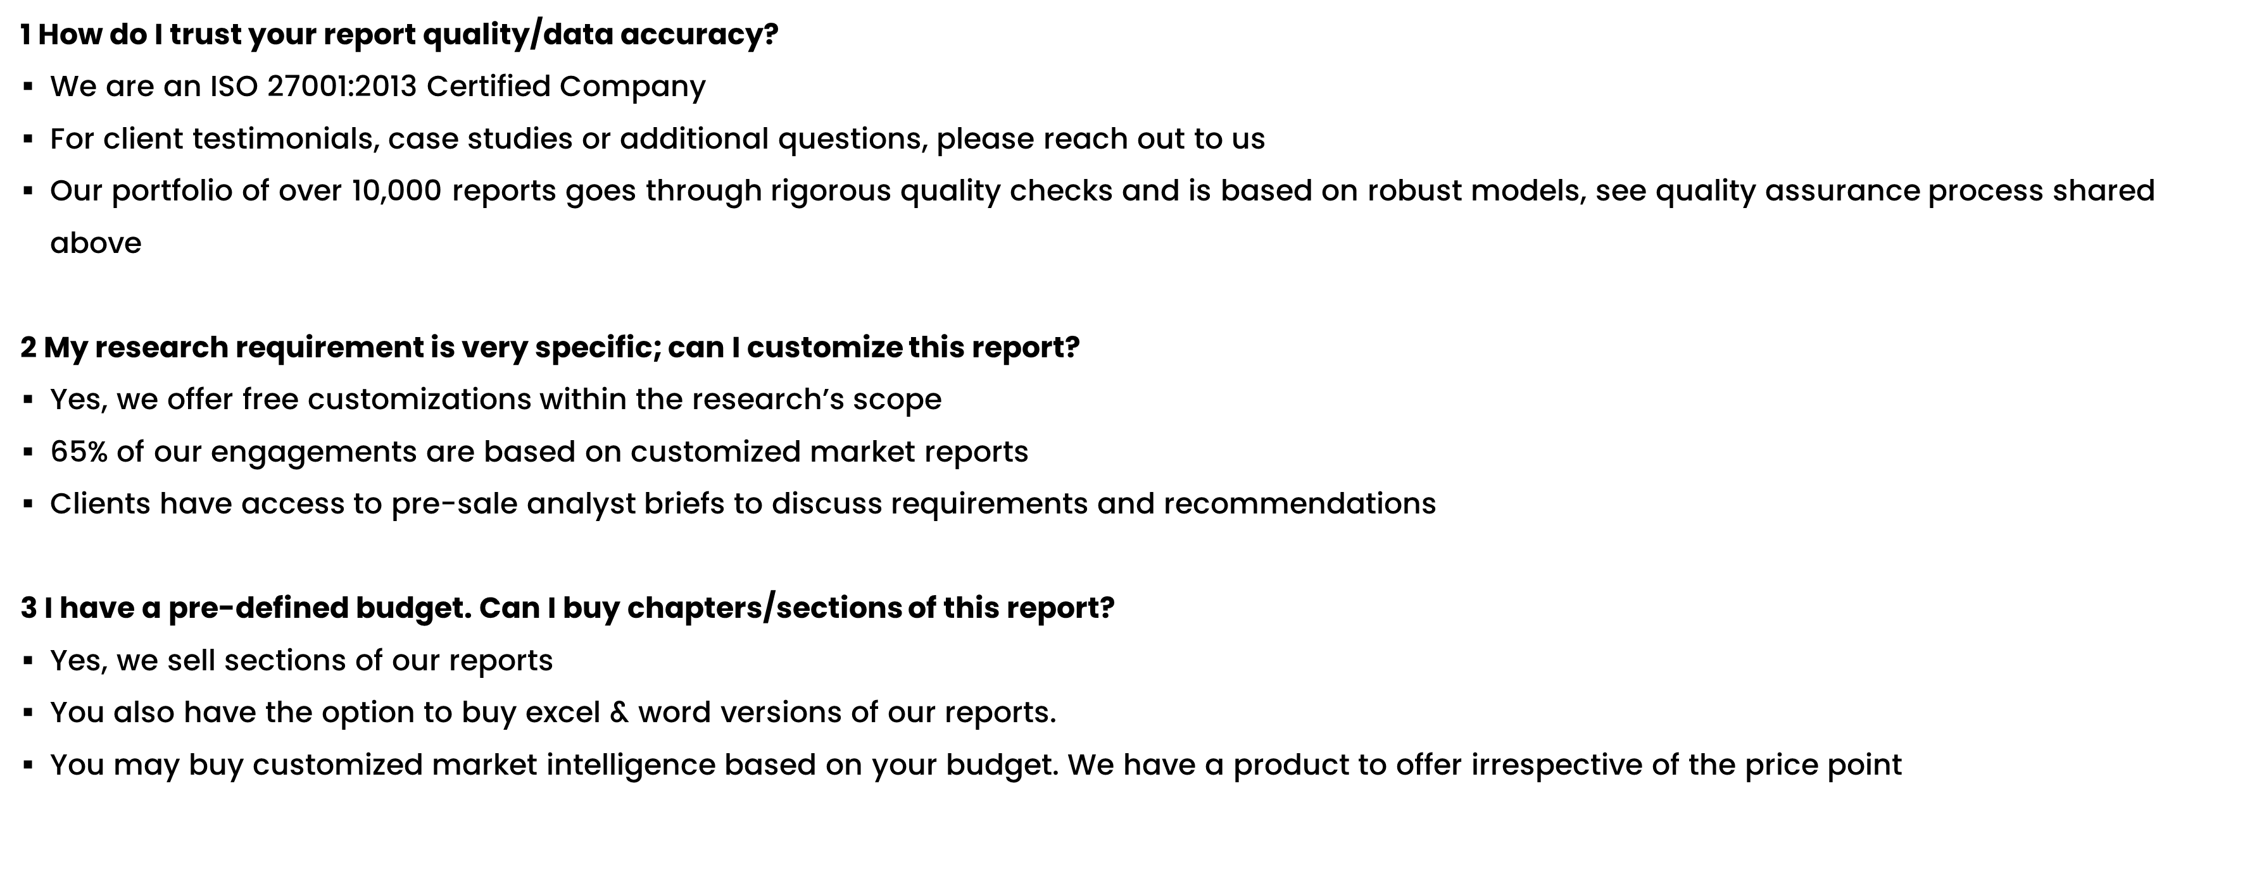
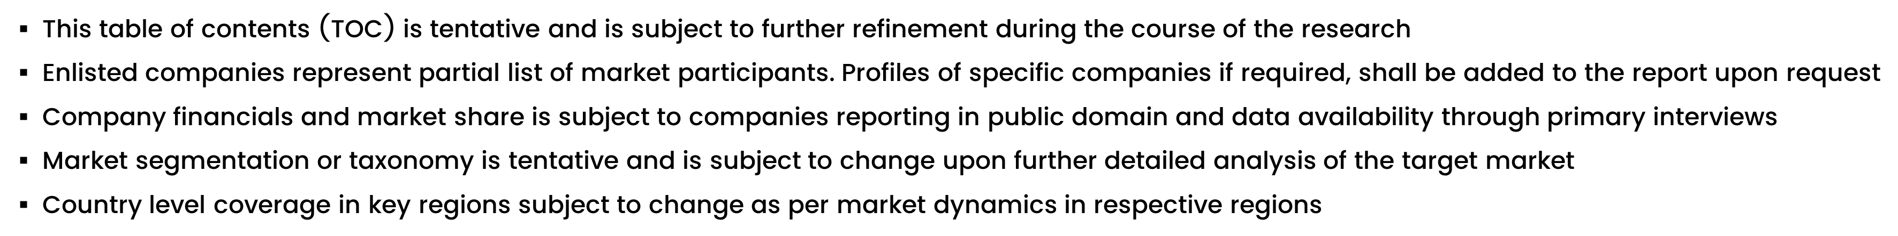
FAQs
NOTE

Slide 39






DISCLAIMER
SkyQuest provides strategic analysis to a select group of customers in response to orders. Our customers acknowledge when ordering that these strategic analysis for internal use and not for general publication or disclosure to any third party. SkyQuest does not endorse any vendor, product, or product type profiled in its publications. SkyQuest's strategic analysis constitutes estimations and projections based on secondary and primary research and are therefore subject to variations.
SkyQuest disclaims all warranties, expressed or implied, with respect to this research, including any warranties of merchantability or fitness, for any particular purpose. SkyQuest takes no responsibility for incorrect information supplied to it by manufacturers or users.
Trademarks, copyrights, and other forms of intellectual property belong to SkyQuest's respective owners and are protected by law. under no circumstance may any of these be reproduced, copied, or circulated in any form, without the prior written approval of SkyQuest's owner-as the case may be no part of this strategic analysis may be given, lent, resold, or disclosed to any third party, without express permission from SkyQuest team.
Reproduction and/or transmission in any form and by any means, including photocopying, mechanical, electronic, recording, or otherwise, without the permission of SkyQuest, is prohibited.
HEADQUARTERS
1 Apache Way, Westford, Massachusetts 01886, United States
APAC OFFICE
Room A & B, 2nd Floor, Lee Kee Commercial Building, 221-227, Queen’s Road Central, Hong Kong
GLOBAL DELIVERY CENTER
D-1001-1005, Swati Clover, Shilaj Circle, Sardar Patel Ring Rd, Thaltej, Ahmedabad, Gujrat-380054
WE ARE REACHABLE AT :-
info@skyquestt.com
+1-617-230-0741
www.skyquestt.com

Slide 40
THANK YOU
www.skyquestt.com

